Slide 1
Software Testing Methodologies
Prashant Joshi

Slide 2
Module 7: Agenda
Module 7: Model Based Testing (1/2)
Topic 7.1
Model Based Testing – Introduction & Overview
Topic 7.2
Finite State Machines & Fault Model
Topic 7.3
Examples
Topic 7.4
Case Study

Slide 3
Topic 7.1: Model Based Testing – Introduction & Overview

Slide 4
Model Based Testing
Process of creating a Model results in deeper insights and understanding of the system
Adequacy of MBT – depends on accuracy of the Model
Sequence of steps
Model the system
Identify the threads of system behavior in the model
Transform threads into test cases
Execute the test cases (on actual system) and record the results
Revise the model(s) as needed and repeat the process

Slide 5
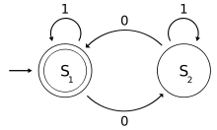
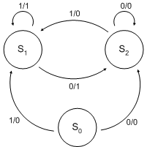
Executable Models
Finite State Machines
Petri Nets
StateCharts

Slide 6
What System Is?
The Components
Their Functionality
Interfaces
All that emphasizes structure

Slide 7
What System Does?
Decision tables
State Charts
Petri nets/EDPN
FSM/EFSM
All these describe System Behaviour
Look for expressive capabilities of the system

Slide 8
Modelling
What the system is
Emphasize structure
Components, their functionality and interfaces
DFD, Entity/Relation models, hierarchy charts, classes diagrams and class diagrams
What the system does
Emphasize behavior
Decision Tables, FSM, State Charts & Petri Nets
Refer: Page 225 and 226 of T1

Slide 9
Model Based Testing Tools
Modelling the system provides ways to generate test cases automatically
Example: http://graphwalker.org/index

Slide 10
Software Testing Methodologies
Prashant Joshi

Slide 11
Topic 7.2: Finite State Machine & Fault Model

Slide 12
Finite State Machines
Method of expression of a design
Simple way to model state-based behavior
State Charts – a rich extension of FSM
Petri nets – useful formalism to express concurrency and timing

Slide 13
State Based Testing
State “Behaviour” exhibited
Example: Stack
Operation pop
s.push(5);
y=s.pop();
print(y);
Y=5
s.push(5);
s.push(7);
y=s.pop();
print(y);
Y=7

Slide 14
State Based Testing
Testing state based components
State-full
State-less
Testing only individual methods or functions for state-full components is not sufficient

Slide 15
State-full Component
A set of States
Transition between states

Slide 16
State-full Component
Objects/Classes
Control Systems
Embedded Systems
Communication Systems
…

Slide 17
State Based Component
States | Values (of some data)
Empty State | top=0
Full State | top=10
Partial State | 1<=top<=9

Slide 18
State Based Modeling Techniques
State transition diagrams
Extended Finite State Machines

Slide 19
State Transition Diagram
A State
A transition
event/action
S1
S2

Slide 20
The Fault Model
Process of Design
Conforming of the implemented system to the Requirements
Fault Model defines a set of small set of possible fault types that can occur
Our focus here is FSM or EFSM (Lets talk modelling later!)

Slide 21
Fault Categories
Operation Error
Error generated upon transition
Incorrect output function
Transfer Error
Incorrect state transition
Extra State Error
Missing State Error

Slide 22
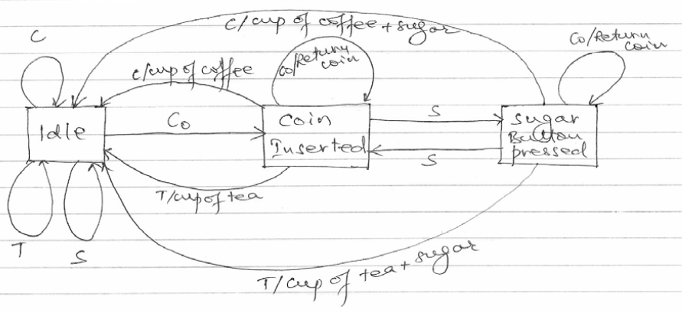
Vending Machine
C: Coffee Button pressed
T: Tea Button pressed
S: Sugar Button pressed
Co : Coin inserted
C
Coin
S
T

Slide 23
Some examples to discuss
Garage Door
Building Lighting Control System
Lift/Elevator Control System (One or Multiple)
A MMI (Man-machine interface) Interface of an instrument

Slide 24
Software Testing Methodologies
Prashant Joshi

Slide 25
Topic 7.3: Examples

Slide 26
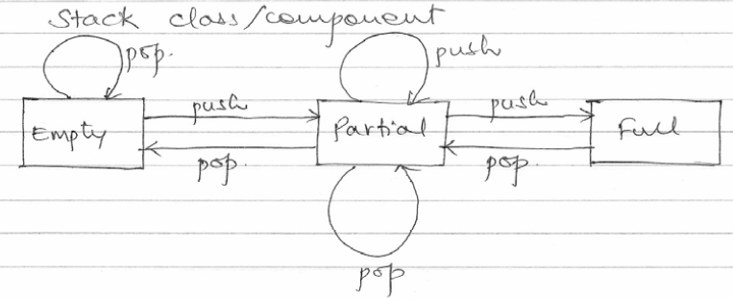
Stack
Simple stack
Operations (push and pop)

Slide 27
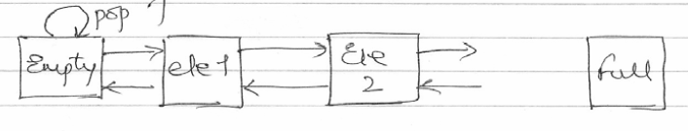
Notion of State Explosion
Too many states
State Explosion problem!

Slide 28
Extended FSM
Extended Finite State Machine
Extension of the state transition diagram by introducing
Variables
Conditions
Event[condition]/action
S1
S2
The system is in S1
Event occurs
Condition evaluates to true
Transition from S1 to S2 takes place
Action is performed

Slide 29
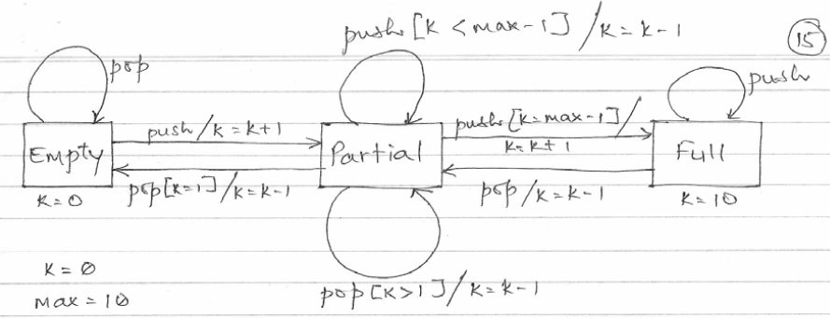
Stack

Slide 30
Testing Stack Component
Operations/methods
Push
Pop
State based testing

Slide 31
Testing with Criteria
State Testing
Every state in the model should be visited at least once
Transition Testing
Every transition in the model is “traversed” at least once
Path Testing
Traverse every path in the model at least once

Slide 32
State Coverage
Test #1: s.push(5) //partial state
Test #2: s.push(5)
s.push(7) 10 push operations
s.push(20) //full state
State Coverage Satisfied

Slide 33
Transition Coverage
Test #3: y.pop()
Test #4: s.push(5)
y.pop()
Test #5: s.push(5)
s.push(7)
s.push(20)
s.push(12)
11th push

Slide 34
Transition Coverage
Test #6: s.push(5)
s.push(7)
y=s.pop()
Test #7: s.push(5)
s.push(7)
s.push(17)
y=s.pop()
10 push

Slide 35
Constrained Path Testing
Modified Path Testing
Traverse every path in the model under the constraint that any transition in the path is traversed at most N times

Slide 36
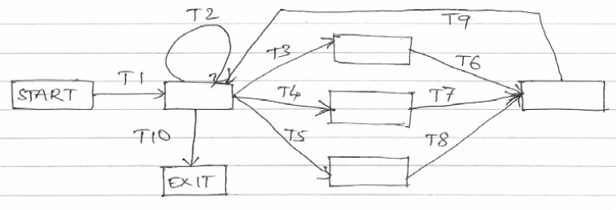
Constrained Path Testing
Use of n=1 (Say repeat only once)

Slide 37
Constrained Path Testing
T1: T1, T10
T2: T1, T2, T10
T3: T1,. T3, T6, T9, T10
T4: T1, T2, T3, T6, T9, T10
T5: T1, T3, T6, T9, T2, T10
T6, T1, T4, T7, T9, T10
T7, T1, T2, T4, T7, T9, T10
T8: T1, T4, T7, T9, T2, T10
T9: T1, T5, T8, T9, T10
T10: T1, T2, T5, T8, T9, T10
T11: T1, T5, T8, T9, T2, T10

Slide 38
State Based Testing
We use state model to design test cases using different strategies
State Testing
Transition Testing
Path/Constraint path testing
Non-executable elements e.g comments in a code.

Slide 39
Software Testing Methodologies
Prashant Joshi

Slide 40
Topic 7.4: Case Study

Slide 41
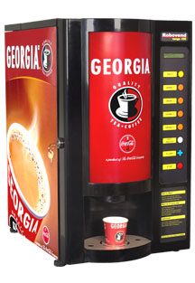
Simple Vending Machine
Tea/Coffee vending Machine
Options
Accepts token/coin
Sugar

Slide 42
Vending Machine
C: Coffee Button pressed
T: Tea Button pressed
S: Sugar Button pressed
Co : Coin inserted
C
Coin
S
T

Slide 43
Software Testing Methodologies
Prashant Joshi

